Slide 1
A340 Lecture 11
Parameter passing continued …

Slide 2
GET
Included in an URL:
index.php?action=login&name=bill&password=blugooze
Method used by a form:
<form method='GET' action='index.php'>
….
</form>
Combination:
<form method='GET' action='index.php?action=chaos'>
….
</form>

Slide 3
POST
Method used by Form:
<form method=’POST' action='index.php'>
….
</form>

Slide 4
GET vs POST
GET
POST
Transmits data in the query line
Displayed in the URL window
Not seen in the page source
Transmits data in the message body
Not displayed by the browser window
Seen in the page source

Slide 5
Cookie
A cookie is a small file that the server embeds on the user's computer.
Each time the same computer requests a page with a browser, it will send the cookie in the http header.
The response http header can contain instructions for setting cookies
With PHP, you can both create and retrieve cookie values.
Setting a cookie must be done before any other communication.

Slide 6
Setting a cookie
Setting a cookie
Syntax:
setcookie(name, value, expire, path, domain);
Example:
<?php
setcookie("user", "Alex Porter", time()+3600);
?>
<html> <body> </body> </html>
Deleting a cookie
Set value to null string
Set expiry time to the past

Slide 7
Retrieving a cookie
$_COOKIE system array:
<?php // Print a cookie echo $_COOKIE["user"];
?>
$_REQUEST contains a mix of GET, POST and COOKIE data

Slide 8
Session
SESSION variables stores user information on the server for later use
However, session information is temporary and will be deleted after the user has left the website.
If you need a permanent storage you may want to store the data in a database.
Sessions work by creating a unique id (UID) for each visitor and store variables based on this UID.

Slide 9
Starting a session
Starting:
<?php session_start(); ?>
<html>
<body> </body>
</html>
Setting variables
<?php session_start();
if(isset($_SESSION['views'])) $_SESSION['views']=$_SESSION['views']+1; else $_SESSION['views']=1; echo "Views=". $_SESSION['views'];
?>

Slide 10
Reading session variables
$_SESSION
<html>
<body>
<?php
echo "Pageviews=". $_SESSION['views'];
?>
</body>
</html>
Destroying a variable
<?php unset($_SESSION['views']);
?>

Slide 11
Functions
<html>
<body>
<?php
function showdept()
{
echo ”IUSB Informatics";
}
showdept();
?>
</body>
</html>
function.lib
function showdept()
{
echo "IUSB Informatics";
}
index.php
<html>
<?php require(’function.lib’); ?>
<body>
<?php showdept(); ?>
</body>
</html>

Slide 12
Function parameter and global variables
function showerr1($num,$msg) {
echo ”<p>” . $num. ”: ” .
$msg . ”</p>\n”;
}
function showerr2($num) {
global $errmsg;
echo ”<p>” . $num. ”: ” .
$errmsg[$num] . ”</p>\n”;
}

Slide 13
Returning values from Functions
function c2f($temp) {
return ($temp * 9.0/5) + 32;
}
function f2c($temp) {
return ($temp – 32) * 5.0 / 9 ;
}

Slide 14
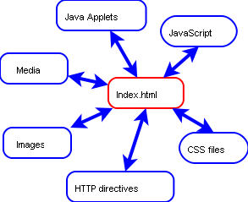
Auxilary components loaded by HTML

Slide 15
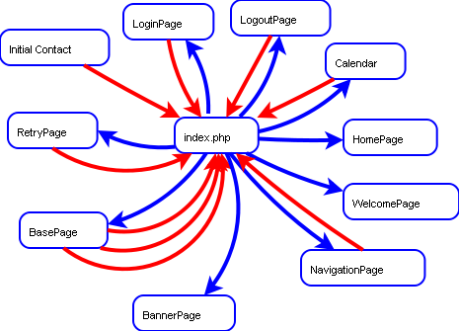
Our project

Slide 16
Index.php: Main site logic
$name = $_REQUEST['name'];
$action = $_REQUEST['action'];
$password = $_REQUEST['password'];
if (valid_name($name))
{
# CHECK ALL ACTIONS
…
}
else
{
# send login page
}

Slide 17
Index.php: Main site logic
$name = $_REQUEST['name'];
$action = $_REQUEST['action'];
$password = $_REQUEST['password'];
if (valid_name($name))
{
do_action();
}
else
{
login();
}

Slide 18
Response manager:
# Check Requested Action
switch($_REQUEST['action'])
{ case 'login': # CHECK IF USER ID PARM EXISTS
if (checkuser($name,$password)) # CHECK AUTHORIZATION
{ base_page($name); }
else
{ retry_page(); }
break;
case 'home': home_page($name); break;
case 'welcome': welcome_page($name); break;
case 'logout': logout_page($name); break;
case 'banner': banner_page(); break;
case 'nav': nav_page($name); break;
default: login_page();
}
}

